Slide 1
The Discussion Forum - latest developments, results from user survey and from member analysis
forum.susana.org

Slide 2
Content
Introduction to the discussion forum *
Latest developments this year
Results from forum user survey
Results from member analysis
Plans and conversations about the future of the discussion forum
Annex
* A longer powerpoint presentation with facts about the discussion forum and a moderator guide is available here: https://www.susana.org/en/knowledge-hub/resources-and-publications/library/details/3630

Slide 3
1. Introduction to the discussion forum

Slide 4
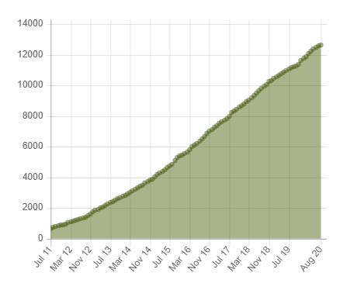
Quiz questions and answers
How many SuSanA members are there? Around 13,100 (10 Dec 2020)
Which is the country with the most SuSanA members? India, 2020 people
SuSanA members
since start of the forum in July 2011
All SuSanA members have access to the discussion forum (= one database of people)

Slide 5
Goal and objectives of the Forum
Goal:
The Forum makes knowledge, ideas, and debates around sustainable sanitation accessible to everyone within the network and beyond.
Objectives:
To accelerate learning within the sanitation sector
To facilitate sharing of knowledge
To help people to network within the SuSanA community

Slide 6
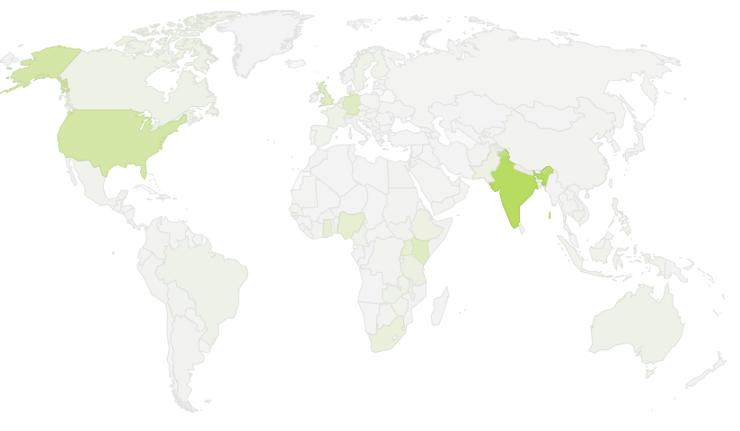
Location of SuSanA members
(currently 13,000 members)
629 (UK)
634 (Germany)
1064 (USA)
457 (Nigeria)
2003 (India)
Countries with most members:
India
USA
Kenya
Germany
United Kingdom
Nigeria
Uganda
400 (Uganda)
679 (Kenya)
Date: 13 Aug 2020
Source: Forum Statistics Page, based on self-identification of members during registration process

Slide 7
Characteristics of the Forum (1 of 2)
Convenience and efficiency for sharing information, experiences and practical problem solving ideas.
More efficient overall than e-mails between individuals
Posts can be made online or sent by members via e-mail to posting@forum.susana.org
Accessible to anyone with internet access
All posts can be found and viewed by anyone (no login required for reading)
Multiple languages: Users can post in their own language, although most of them post in English (if another language is used, the moderators use Google Translate or Deepl to translate it to English)

Slide 8
Characteristics of the Forum (2 of 2)
Inclusive:
Open, friendly, welcoming atmosphere, respect and passion for the cause to provide sustainable sanitation.
Focus:
The main focus is sustainable sanitation.
We also discuss topics that are linked to sanitation, or are cross-cutting for the WASH sector as a whole, for example equity and inclusion.
Supportive and fun:
Communicating in a personal, friendly non-anonymous manner.
The community moderators are recreating on the Forum the ‘SuSanA spirit’ which is about a desire to collaborate and share.

Slide 9
The Forum has eight categories
Thematic categories:
Hygiene, health, schools
Sanitation systems
Attitudes & behaviours
Markets, finance & governance
Resource recovery
Equity & inclusion (new in 2020 on initiative by WSSCC)
Admin / Announcement categories:
Working groups and regional chapters
Announcements & miscellaneous
Notes:
Updated 04.06.2014
Categories:
New posts are feeded into the home page
Most popular topics

Slide 10
Contributions of the Forum to the WASH sector
Accessibility of information and reports - allowing for critical feedback
Networking, finding jobs, helping newcomers to get visibility
Exchange platform for announcements and news, but also controversial discussions and new topics to take place
Increased outreach and dissemination
of events by linking with online discussions on the Forum before, during and after the event
of publications
of project or research results
Knowledge management of project and research outcomes
→ One-stop shop for all sanitation-related topics and an exchange platform for sanitation practitioners

Slide 11
Contributions of the Forum beyond the WASH sector (benefits for the general public)
If people use Google searches on various topics, they might be directed to
the SuSanA Discussion Forum
Wikipedia
We are using interactions on the Discussion Forum as inspiration to improve Wikipedia articles (see for example here on the Forum).
Therefore, we are helping the public find information about WASH topics.

Slide 12
back
2. Latest developments this year

Slide 13
What's new in 2020 with the forum?
Funding of forum moderators and IT work provided by WSSCC via a grant to Skat Foundation
Closer and renewed cooperation between SuSanA and WSSCC (forum thread)
New moderators and various other outputs, see next slides
Cooperation between SuSanA and FSMA with some funded hours of forum moderation (forum thread)

Slide 14
Work carried out in 2020 (1 of 2)
(made possible due to WSSCC funding)
Three new part-time co-moderators from Global South recruited and trained (see later)
Our hypothesis is that the forum would work better with several moderators, and even better if the moderators were from developing countries
Continued funding of main moderator (Elisabeth von Muench)
New forum category on „Equity and inclusion“ (259 threads so far; some existing sub-categories moved to there)
New sub-category on Covid and WASH (33 threads so far)
Monthly meetings of Forum Practice Group for all matters that are forum-related
Discussion Forum user survey (forum thread) in August, six years after the first one in 2014.

Slide 15
Sub-categories within the new category: “Equity and inclusion”
Sub-category title | Threads *
People with disabilities | 27
Menstrual hygiene and health | 150
Gender issues | 26
Human right to water and sanitation | 18
Sanitation workers | 30
Inclusive programming and other topics under equity and inclusion | 8
* The number of discussion threads (or topics) is cumulative up until 18 Aug 2020

Slide 16
Work carried out in 2020 (2 of 2)
(made possible due to WSSCC funding)
Various IT improvements:
Upgrade of discussion forum software (Kunena) to latest version
Forum posts can now – finally!- be written in a Word-like editor (WYSIWYG) (forum thread)
New statistics pages
Added events from events calendar to forum digest
Added a gender field to the registration form to understand better the member diversity
Continued Wikipedia editing, e.g. Sanitation worker, WASH, SBM

Slide 17
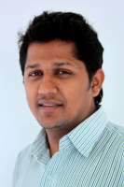
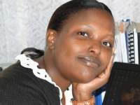
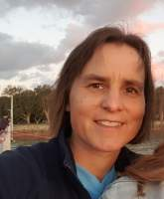
New part-time co-moderators in 2020
(1-2 days per week)
Paresh Chhajed-Picha in Mumbai, India (February to current), also a PhD student
Charlotte Mong-ina Maua in Nairobi, Kenya (February to May), also a WASH consultant
Chaiwe Mushauko-Sanderse in Lusaka, Zambia (June to current), also a WASH consultant
and Elisabeth von Muench continues as main moderator since 2011, currently 1 day per week

Slide 18
What is the job of the Forum moderators all about?
Ensure the Forum meets its goal: “The Forum makes knowledge, ideas, and debates around sustainable sanitation accessible to everyone within the network and beyond.”
Ensure integrity and quality
Encourage activity on the Forum
aim for lots of high quality posts from a diverse range of people
Provide a friendly, fun and supportive online space for all users
Ensure users adhere to the Forum rules
Prevent take over from spammers
Ensure ongoing improvements to IT infrastructure
Raise profile of the Forum in the sector
Make the forum into a “buzzing” space that everyone in the WASH sector knows about and loves
Interlink with other activities of SuSanA

Slide 19
Advantages of having several, and diverse moderators (especially from Global South)
Broaden the content – more brain power, bigger range of ideas
Add variety in style – it can be boring for participants to read too many posts of the same person
Grow the network – moderators to tap into their own networks
Spread the risk – if main moderator disappears then other moderators will know what to do.
Increase funding options – some of the co-moderators could be self-funded, funded as an in-kind contribution by their employer or even plain volunteers
Reach out to users with other languages

Slide 20
Forum posts and new members per month
(during different funding phases, 2011-2020)
BMGF 1
BMGF 2
BMGF 3
GIZ
WSSCC 1
[...]
Funding for moderation and IT development:
BMGF 1, 2, 3 (1: Nov. 2012 - Apr. 2014, 2: July 2014 - Dec. 2015, 3: Oct. 2016 - Oct. 2018)
GIZ (March to Oct 2019)
WSSCC (Nov 2019 to Dec 2020)
New members surprisingly constant
Posts per month varies widely
Notes:
Updated 25.7.2014

Slide 21
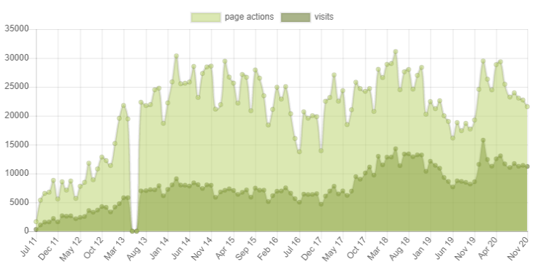
Forum page actions and visits per month (2011-2020)
More page actions and visits in 2020
Page actions
Visits
Technical problem with data collection
From 1 Nov 2014 onwards, the data shown here is by Piwik. Prior to that it was from Google Analytics.
Page actions: Counts any site loads, downloads, video playbacks etc. from any kind of users
Visits: Value of the sum of unique users from a defined location and device within a defined time period
Notes:
No use of google analytics anymore

Slide 22
back
3. Results from forum user survey

Slide 23
Summary of Forum survey results in a nutshell
538 people filled in the survey from 22 July - 16 Sept. 2020 (24% of respondents work for local NGO; 67% from developing countries; 33% female).
63% said the Forum is valuable or very valuable.
“Learning and gaining in-depth knowledge” was the most important activity when using the Forum.
97% of respondents read posts either often, fairly often or occasionally.
43% of survey respondents never write posts (compared to 80% of all SuSanA members who never write posts).
The main barriers to writing posts: “Users are unsure whether they can add anything of value compared to people with more expertise.” and “Users don't have time”.
The main activities that moderators should do: “Write posts to enrich discussions” and “Make newcomers feel welcome by replying to their posts”.
83% of respondents said forum moderators are important or very important.
69% of respondents said they are satisfied or very satisfied with forum moderators.
There were few perceived shortcomings of forum posts but one that was mentioned a bit was “Too few posts from people in developing countries”.
More users want to expand topics to water supply topics (288 responses), compared to users who do not want expansion beyond the current scope (164).
With regards to regions: users had the most interest in Sub-Saharan Africa (248 responses), followed by Central Asia and Southern Asia (182 responses; includes India).

Slide 24
Basic facts about the survey
The survey consisted of 20 questions and took about 5-10 minutes to complete.
The survey ran from 22 July to 16 September 2020.
538 people filled in the survey (this is about 4% of SuSanA members*)
Our aim was to reach 10% of members but it turned out to be quite difficult to get to that number, despite a lot of advertising (due to August being a holiday period? Not enough incentives? Survey too long?)
* The survey was open to all Forum users. We don’t know how many respondents were SuSanA members. Most likely the majority of respondents were SuSanA members.

Slide 25
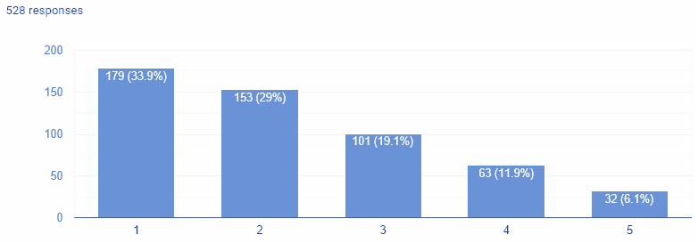
Q1: How valuable is the forum for you?
63% said valuable or very valuable
18% said not valuable
Very valuable Not valuable at all

Slide 26
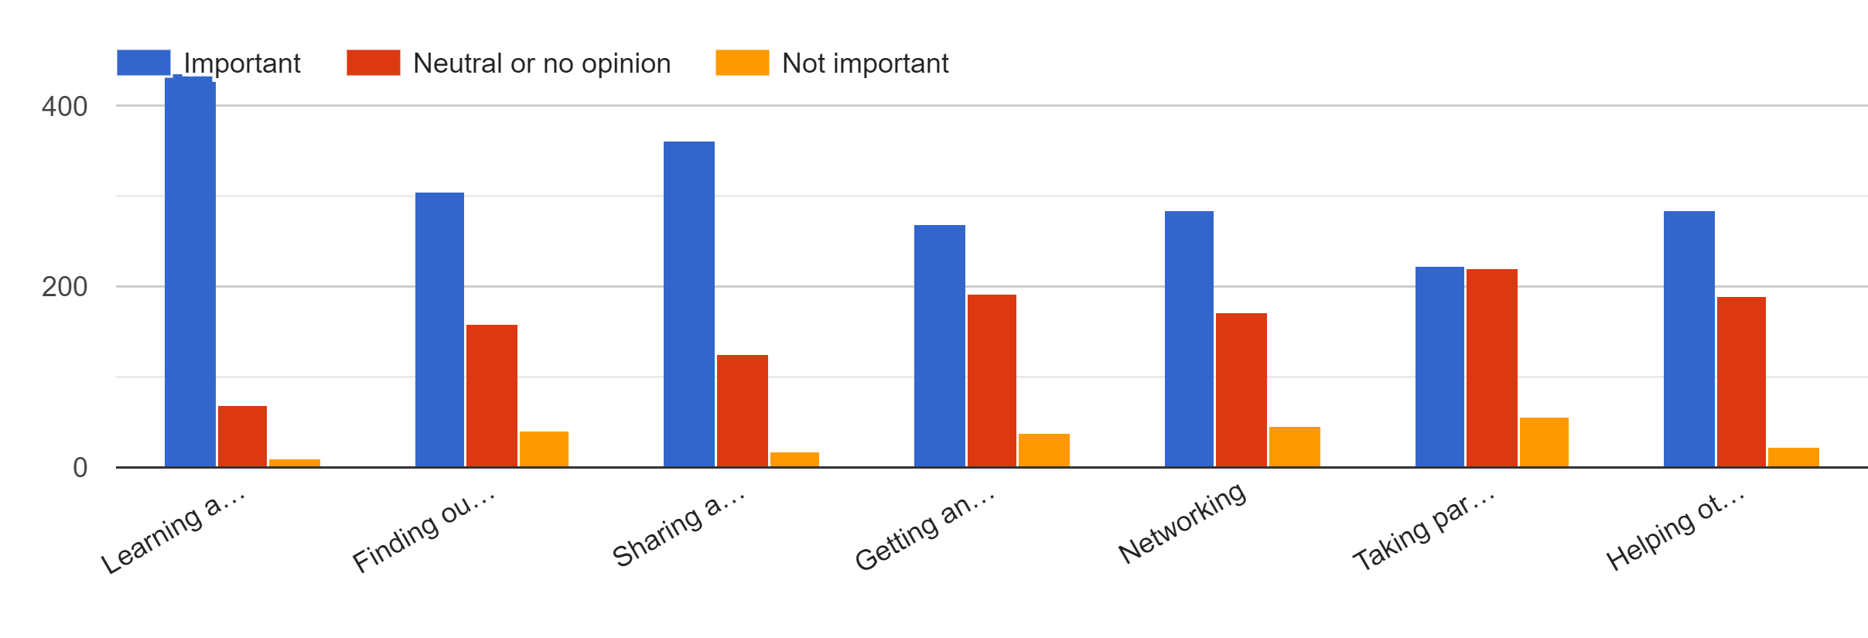
Q3: Importance of activities as a forum user
Learning and gaining in-depth knowledge (important)
Finding out about upcoming events and jobs, reading announcements
Sharing and disseminating information (important)
Getting answers to my own questions
Networking
Taking part in discussions (less important)
Helping others

Slide 27
Q3: Summary: Importance of activities as a forum user (most common answer first)
Learning and gaining in-depth knowledge (436 responses said “important”)
Sharing and disseminating information (363)
Finding out about upcoming events and jobs, reading announcements (305)
Helping others (284)
Networking (284)
Getting answers to my own questions (270)
Taking part in discussions (223)
→ Discussions “for the sake of discussions” is seen as less important compared to the other activities.

Slide 28
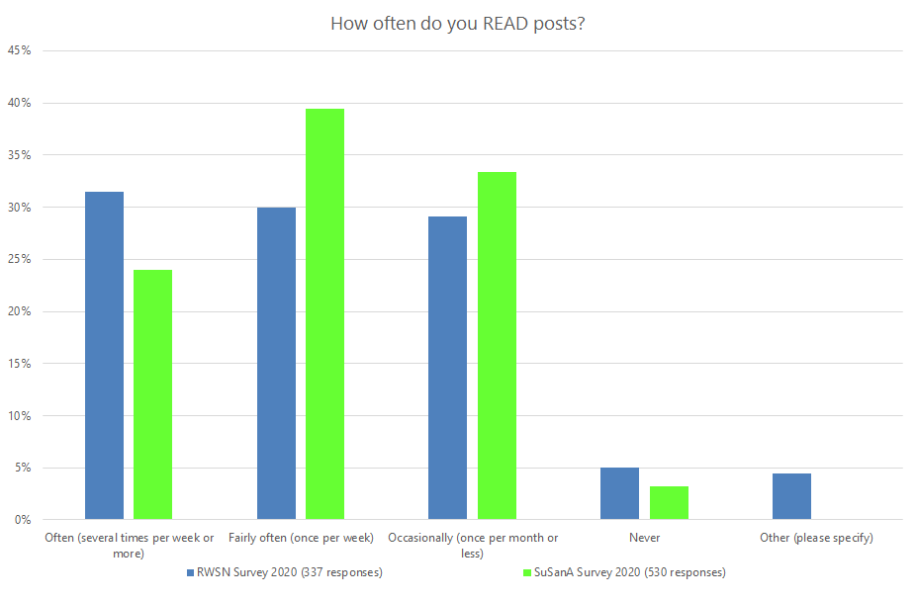
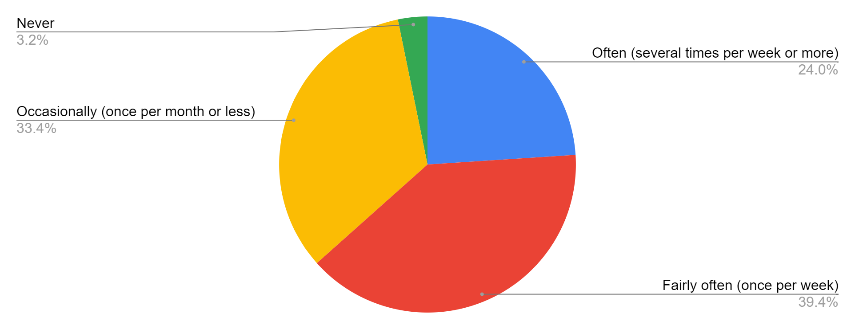
Q2: How often do you read posts on the SuSanA discussion forum or in the e-mail digest?
97% of respondents read posts often, fairly often or occasionally
24% of respondents read posts often.
Only 3% of respondents (17 people) never read forum posts
People read far more posts than they write (see next slide)
530 responses

Slide 29
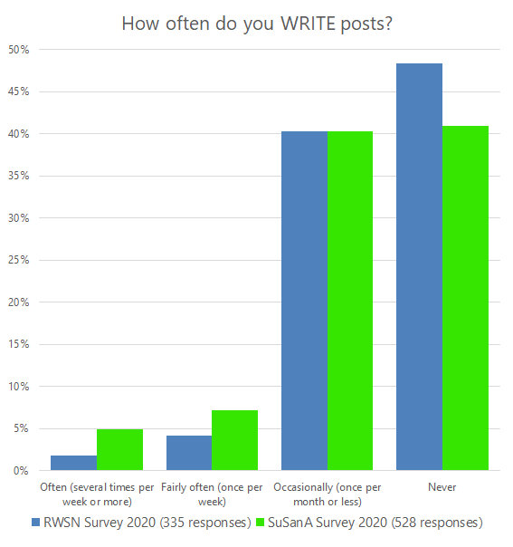
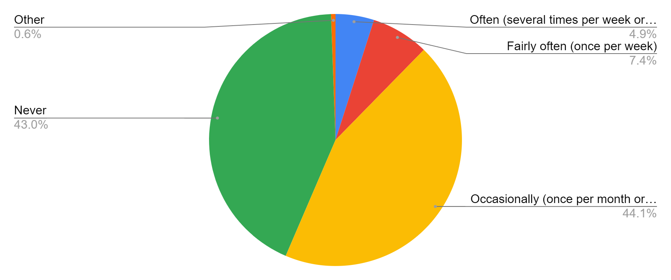
Q4: How often do you write posts?
43% of survey respondents never write posts (compared to 80% of all SuSanA members who have never posted) (see Section 4 of the presentation)
12% of respondents wrote posts “often or fairly often” (compared to only 5% of all SuSanA members (see Section 4)
528 responses

Slide 30
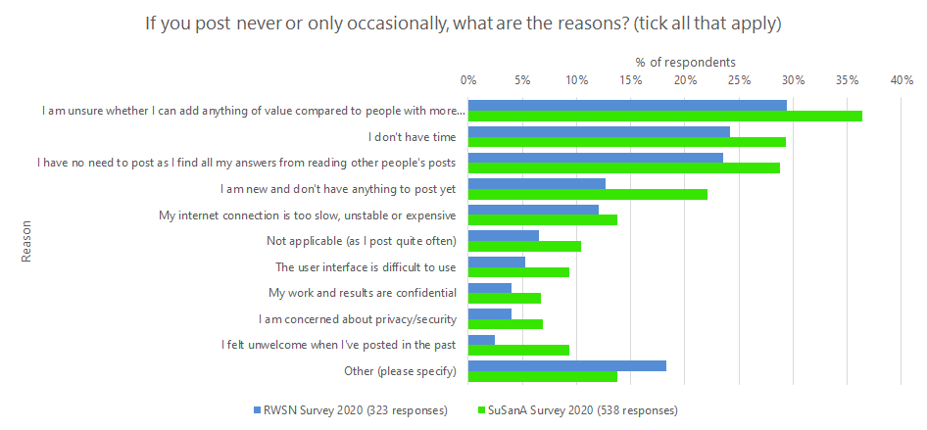
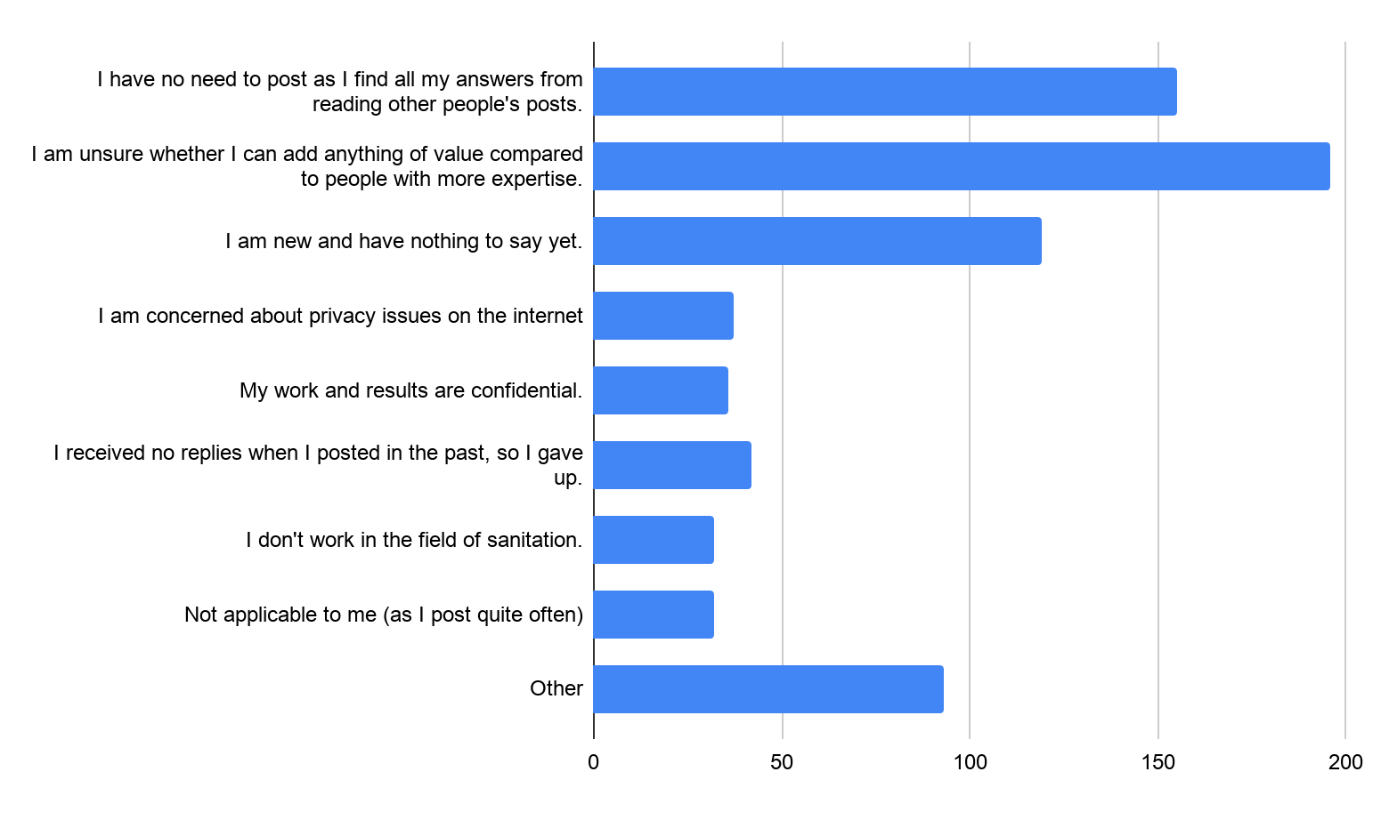
Q5: Barriers to writing forum posts - related to forum topics and content
We need to motivate people and stress the importance of sharing their experiences and opinions.
We need to ensure that all posts get some answers.

Slide 31
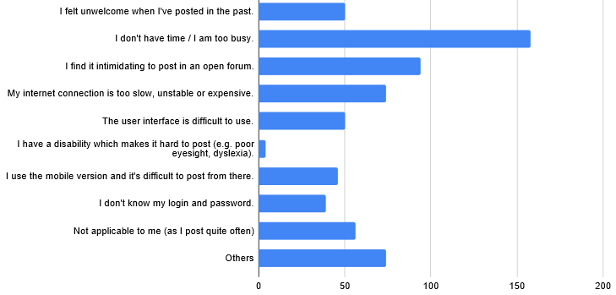
Q6: Barriers to writing forum posts - related to procedures or emotions
We should promote ways to make it less time consuming, e.g. post by e-mail (posting@forum.susana.org)
We could make some changes to the IT infrastructure to reduce these barriers

Slide 32
Q5 & Q6: Summary: main barriers to posting
Users are unsure whether they can add anything of value compared to people with more expertise. (196 responses)
Users don't have time / are too busy. (158)
Users have no need to post as they find all their answers from reading other people's posts. (155)
Users are new and think they have nothing to say yet. (119)
Users find it intimidating to post in an open forum. (94)
Note: we don’t know if the barriers to posting are different for different types of users, e.g. different for Global South members
Example quotes:
It takes efforts to sign up every time and remember the password etc.
No time for it. Would rather use social media channels.
I'm doubtful any posts of mine would be of interest.
Sometimes just scanning the post is also fruitful. If anything is relevant which I could add, then I post some comments. I see no barriers for me. Posting no comments doesn't mean that I don't like this forum. Whenever I receive the newsletter of SuSanA, I take a look through the posts and capture some knowledge. But in general, I don't feel necessary to post any comment.

Slide 33
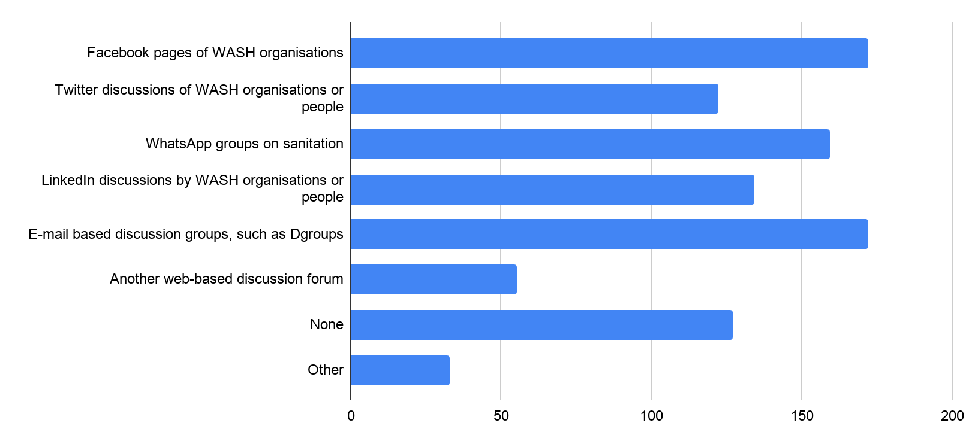
Q7: Which of these other platforms do you use to participate in discussions?
Lots of competition from social media and Dgroups.
People remain logged into their social media accounts and have easy access to it from their mobile phones.

Slide 34
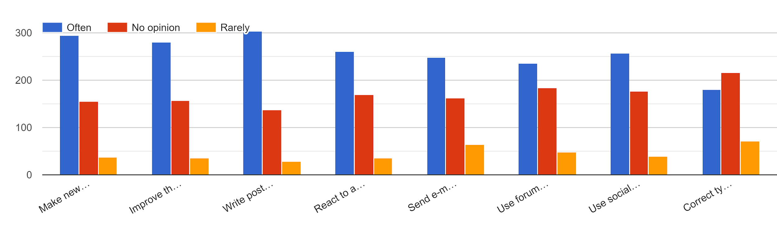
Q8: How often should the forum moderators spend their time on the following activities? (graphical overview)
(Analysis on next slide)

Slide 35
Q8: How often should the forum moderators spend their time on the following activities?
All of the proposed activities were rated as “often”, and are listed below in the order of importance (most important first):
Write posts to enrich discussions (303)
Make newcomers feel welcome by replying to their posts (295 responses for “often”)
Improve thread titles for better clarity (281)
React to any inappropriate postings fast (261)
Use social media to promote forum threads (257)
Send e-mails to encourage more participation (248)
Use forum content to improve Wikipedia pages on WASH topics (235)
Correct typos, broken links or formatting issues in posts (180)

Slide 36
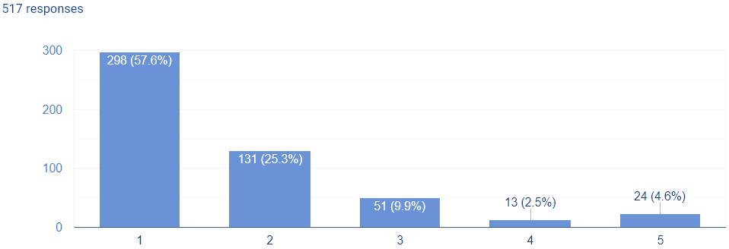
Very important
1
2
3
4
5
Not important at all
Q9: Importance of forum moderators
83% of respondents said forum moderators are important or very important.
7% said they are not important.
Very important Not important at all

Slide 37
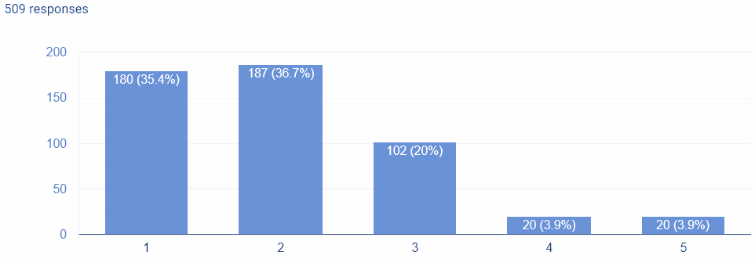
Q10: Satisfaction level with forum moderators
69% of respondents said they are satisfied or very satisfied with forum moderators.
8% said they are not satisfied.
Very satisfied Not satisfied at all

Slide 38
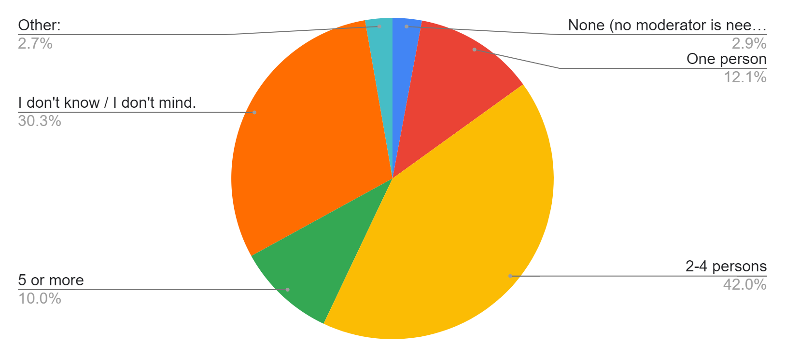
Q11: Ideal number of forum moderators?
42% of respondents said 2-4 moderators are needed, and 30% had no opinion.
The current number is three moderators.
Total: 512

Slide 39
Now let’s look at perceived shortcomings of the forum…

Slide 40
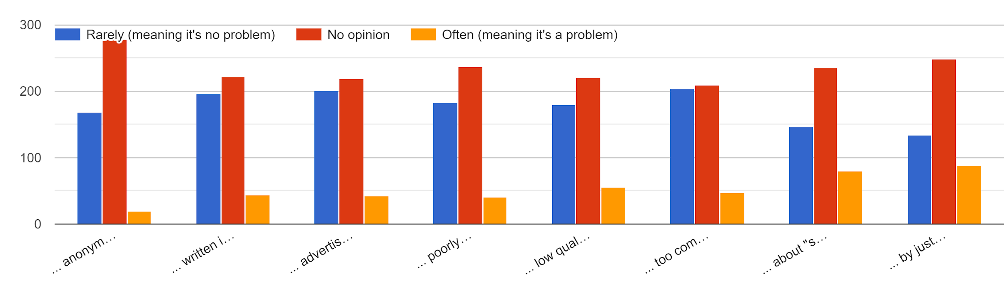
Q12: "There are too many forum posts which are..."
... anonymous (e.g. empty forum profiles)
... written in an aggressive, sarcastic or rude tone
... advertisements
... poorly written, full of typos
... low quality in terms of content
... too complicated or too technical
... about "same old stuff" / boring
... by just a few users who post very often
→ All of these answer options were rated by a majority as “rarely” or “no opinion”.
→ Amongst the ones rated as “often”, only two stick out:
“... about "same old stuff" / boring” (80 responses for “often)
“... by just a few users who post very often” (88)

Slide 41
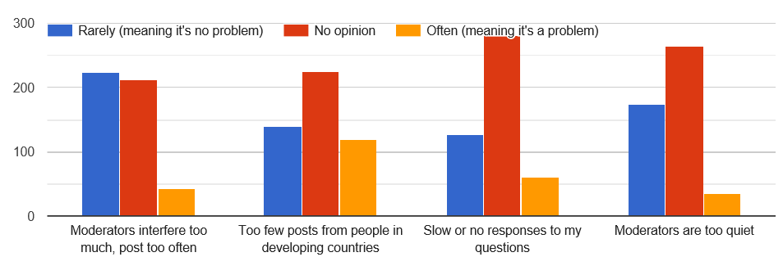
Q13: How often are each of the following statements true?
All of the below statements are regarded as “rare” rather than often. But in the order of “often” the statements were ranked as follows:
Too few posts from people in developing countries (119 responses for “often”)
Slow or no responses to my questions (62)
Moderators interfere too much, post too often (43)
Moderators are too quiet (35)

Slide 42
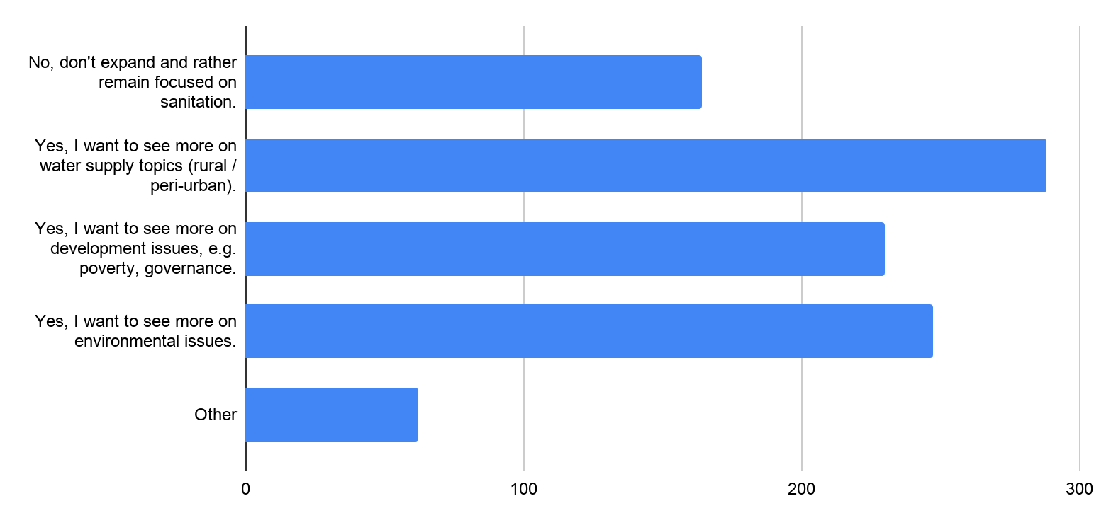
Q 14: Expand forum's thematic focus to other topics?
More users want to expand topics to water supply topics (288 responses), environmental issues (247) and development issues (230) compared to users who do not want expansion (164).
Quote: “Please DON'T expand to water, let RWSN do that, stay focused on sanitation”

Slide 43
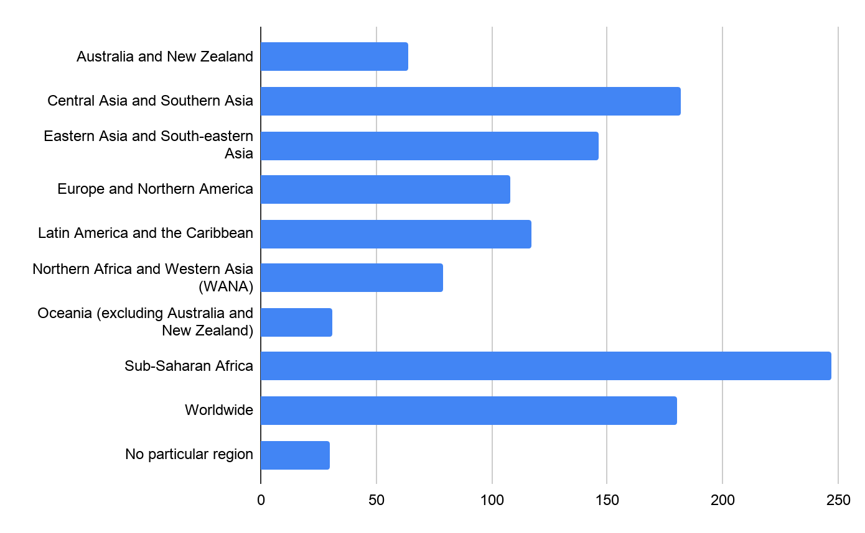
Q 17: Regions where you have the most interest?
Users had the most interest in Sub-Saharan Africa (248 responses), followed by Central Asia and Southern Asia (182 responses; includes India) and “worldwide” (180)
(includes India)

Slide 44
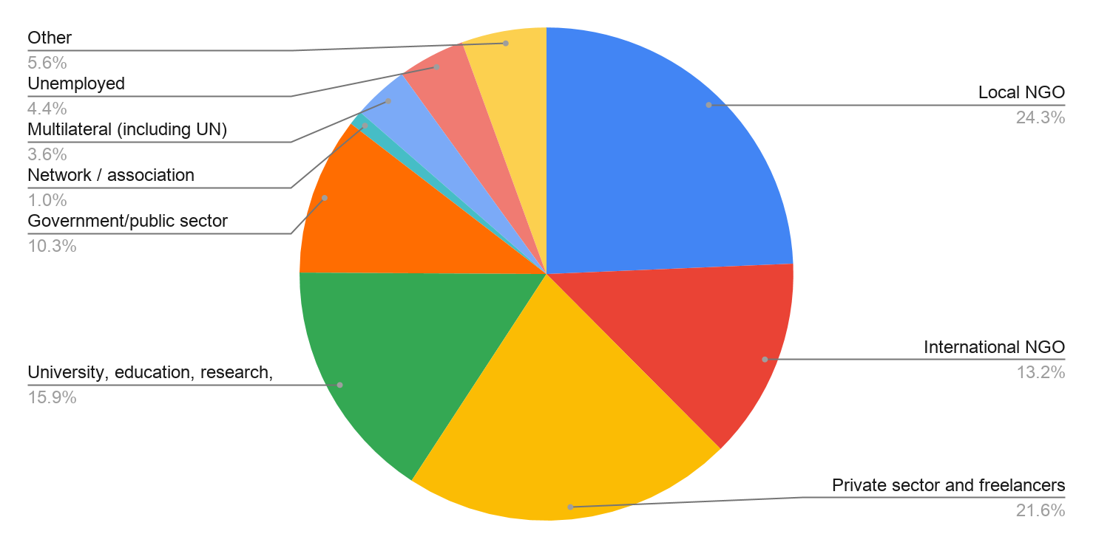
Q18: Your current employer type
Local NGO is the biggest employer type (24%), followed by private sector and freelancers (22%).
Total: 522

Slide 45
back
4. Results from member analysis
Data as of 15 December 2020
These statistics are live updated and are available here: https://forum.susana.org/forum/statistics

Slide 46
Summary of member analysis in a nutshell
For the first time this year we determined the gender ratio of our SuSanA members and grouped their location into Global North or Global South. We also analysed their posts by Forum category. All this data available live here (note there are several tabs).
67% of our 13,000 members live in the Global South (developing countries) - strive for a value of 80% in future?
36% of SuSanA members are female (strive for 50% in future?); this was analysed based on their first names for the past; and self-identified for new or existing members since 16 July.
The %-age of posts by moderators has increased to 28% in 2020 (lowest value was 10% in 2013). Perhaps strive for a maximum value of 20%?
In 2020 there were about 1815 posts, compared to 1392 in the year 2019 (30% increase).
Members from Global South wrote only 34% of all posts - even though 67% of members are from Global South. This means less posts per person for Global South members.
Female members wrote on average 36% of all posts (also 36% of members are female). Hence, the posts per person is the same for males and females.
Females have a preference for certain categories: Females post particularly in „equity and inclusion“ category and females don‘t post as much in „sanitation systems“ category.
20% of SuSanA members have made one forum post or more, whereas the majority of SuSanA members (80%) has never posted. 1% of members have made a lot of posts (30 or more). All “top 10” most active users (all time, since 2011) are male users.
About 2600 SuSanA members have made at least one post since the start of the Forum in 2011.

Slide 47
Answers
Quiz questions and answers
What percentage of our members are female? 36%
What percentage of our members is from the Global South? 67%
This collage consists of SuSanA user profile images from 2014

Slide 48
A new way to analyse and disaggregate forum activities (implemented in Aug 2020)
Posts are analysed by:
Gender of the person who posted
Geographical location of the person (Global North or South)
Moderator or normal user
This analysis is done per category and per year.
We can then establish a baseline and compare year on year.
Aims would be more diverse participation:
More posts by females; more female SuSanA members (aim for 50% of posts and members?)
More posts by members from the Global South (aim for 67% of posts to be from Global South members, i.e. same percentage as current membership figure?)

Slide 49
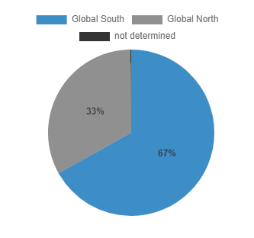
Location of our members / forum users
67% of our 13,000 members live in the Global South (as per SuSanA member database)
Results from member database analysis, see: https://forum.susana.org/forum/statistics?statsview=8
Developing countries = Global South

Slide 50
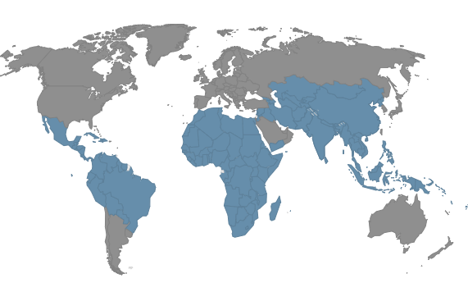
We define these countries as Global South (in blue) based on World Bank classification *
Developing countries = Global South
Member database analysis
* World Bank classification of “high income country” is taken as Global North. All other countries taken as Global South.

Slide 51
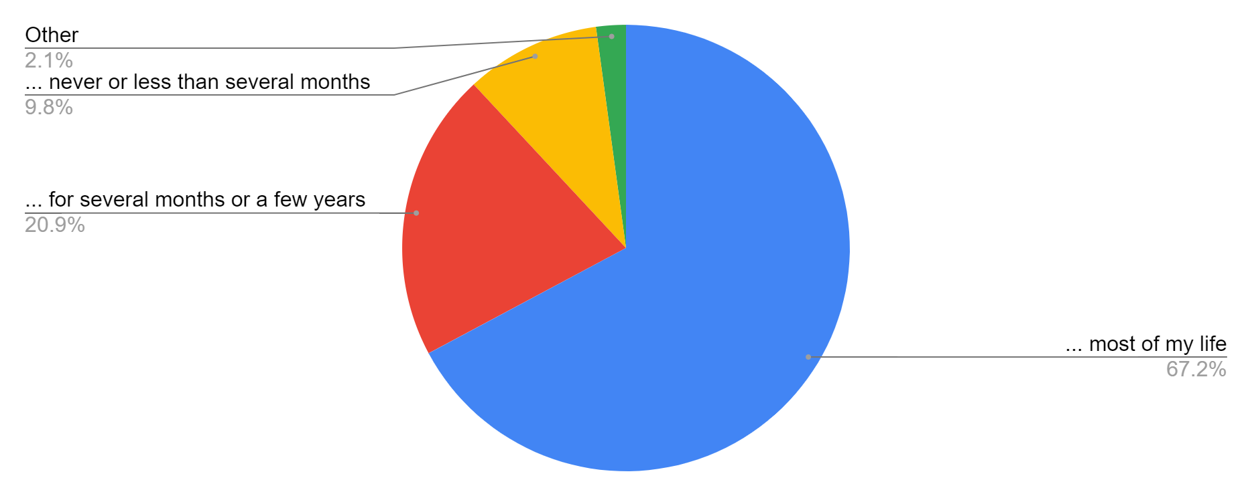
Q15: Have you ever lived in a developing country? (Definition of developing country here)
67% of survey respondents are from a developing country (“most of my life”)
About 90% of survey respondents are either from a developing country or have lived there for several months or more.
These figures match well with the member database results which means survey is representative with regards to country type (67% of SuSanA members from Global South)

Slide 52
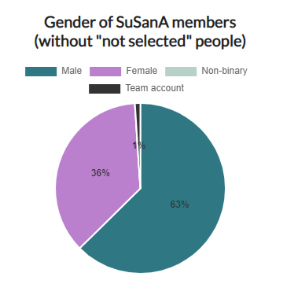
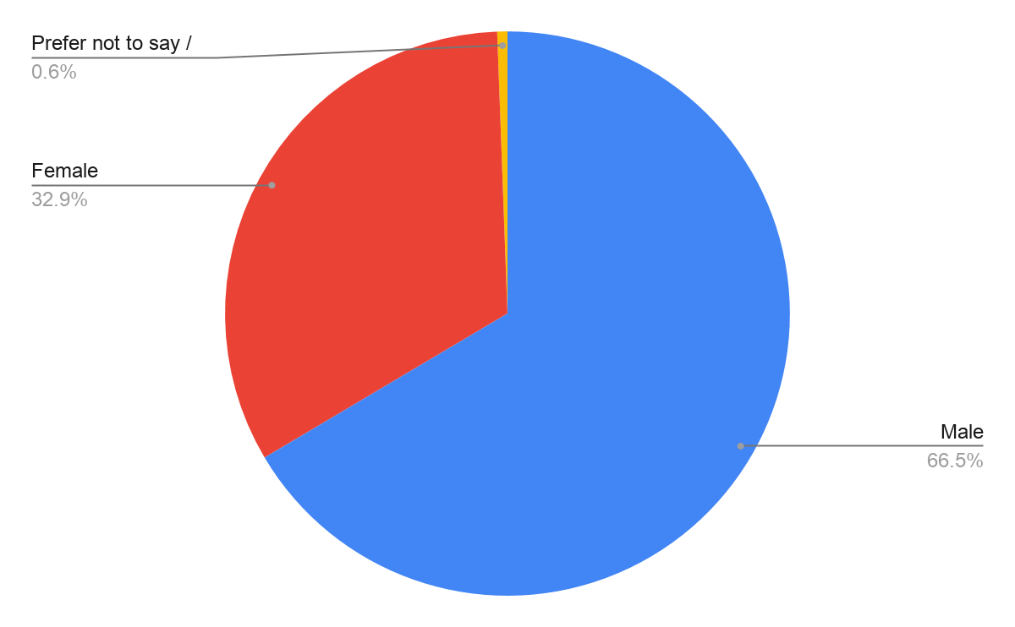
Member analysis by gender
About two thirds males, one third female
Similar result for both analytical methods (this means survey is representative for gender)
Female
Female
(36%)
Female
(33%)
Male
(63%)
Male
(66%)
Male
Survey results to Question 16
(516 responses)
Member database analysis
(based on 10,531 people; we don’t know the gender of 2469 people, or 19%; 107 team accounts)

Slide 53
Quiz questions and answers
How many forum posts are typically made per year? 2000-3000
Which forum category has the most posts? Sanitation systems

Slide 54
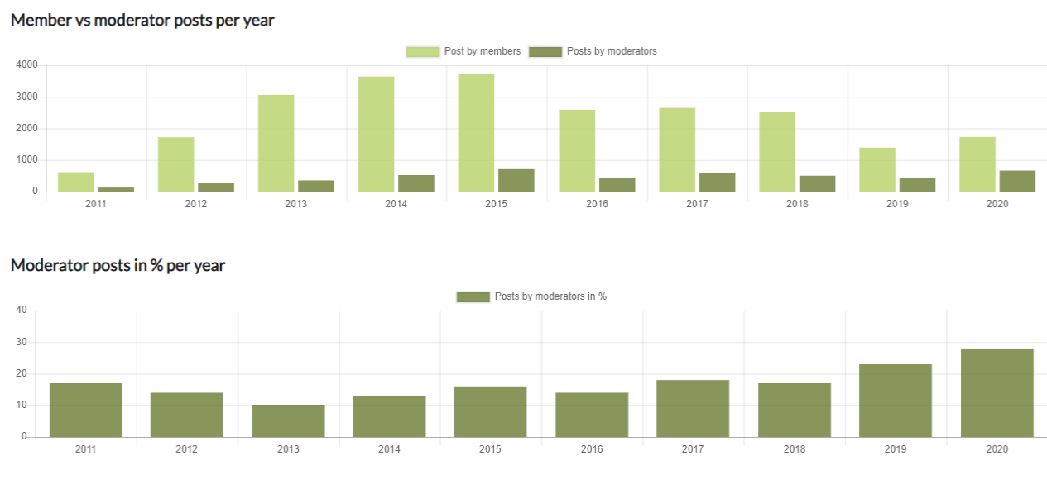
Posts per year for members and moderators
The number of forum posts was highest in 2013-2015 (due to active BMGF grantees).
In 2020 there were about 1815 posts, compared to 1392 in the year 2019 (24% increase).
The %-age of posts by moderators has increased to 28% in 2020, from 23% in 2019 (for the first time in 2020, we had three active moderators).
Current value for 15 Dec 2020 - predicted to reach 1815 by 31 Dec 2020
Only 6 months
1740

Slide 55
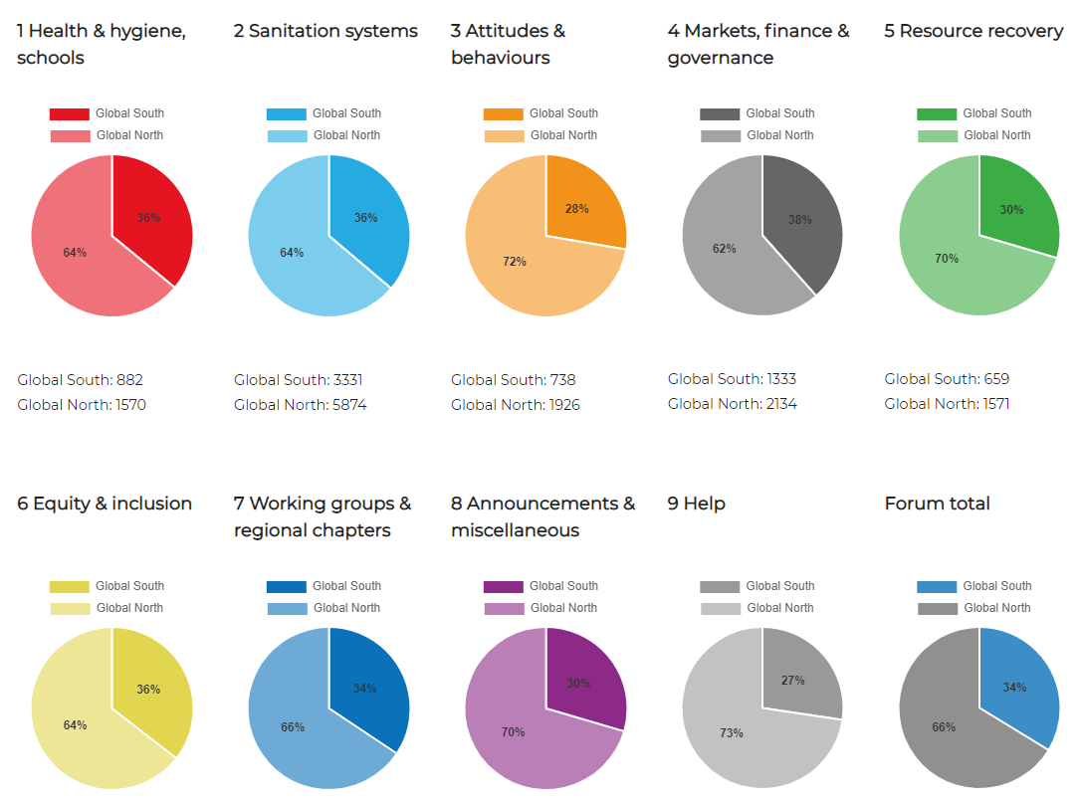
Location of members who have posted, by category
Members from Global South wrote only 34% of all posts - even though 67% of members are from Global South. So posts per person are lower than expected.
Global South
(the darker shadings)
38% Global South members’ posts (highest)
34% Global South
members’ posts overall

Slide 56
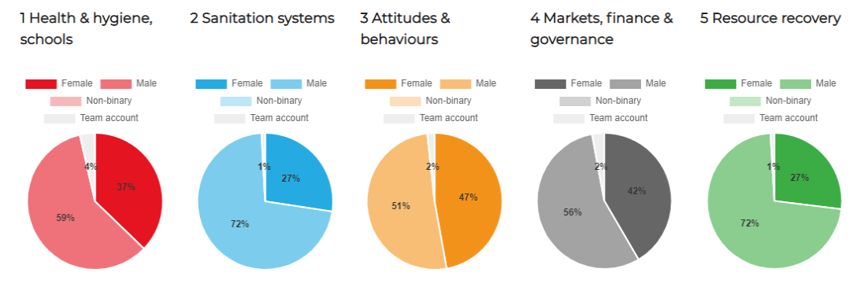
Gender of members who have posted, by category (1)
Only 27% of posts in the category “Sanitation systems” were by female members.
27% female members’ posts
(lowest)
Posts by females
(the darker shadings)

Slide 57
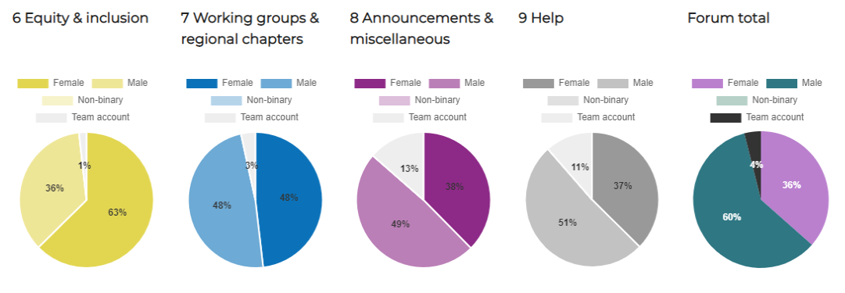
Gender of members who have posted, by category (2)
63% of posts in the „equity and inclusion“ category were by female members.
Female members wrote on average 36% of all posts (and also, about 36% of members are female). This means the posts per person is the same for males and females.
63% Female members’ posts
(highest)
Posts by females
(the darker shadings)

Slide 58
Posts per category by females and from Global South
Females have a preference for certain categories.
Global South members don’t have distinct preferences for categories.
 | Forum category | Total Posts | Posts by females (%) | Posts by members from Global South (%)
1 | Health and hygiene, School | 2356 | 36% | 36%
2 | Sanitation systems | 9534 | 27% | 36%
3 | Attitudes and behaviours | 2573 | 47% | 27%
4 | Markets. finance & governance | 3369 | 42% | 38%
5 | Resource recovery | 1678 | 30% | 30%
6 | Equity and inclusion | 1435 | 63% | 36%
7 | Working groups & regional chapters | 1084 | 48% | 33%
8 | Announcements and misc | 4706 | 37% | 29%
9 | Help | 337 | 37% | 28%
 | Forum total |  | 36% | 34%

Slide 59
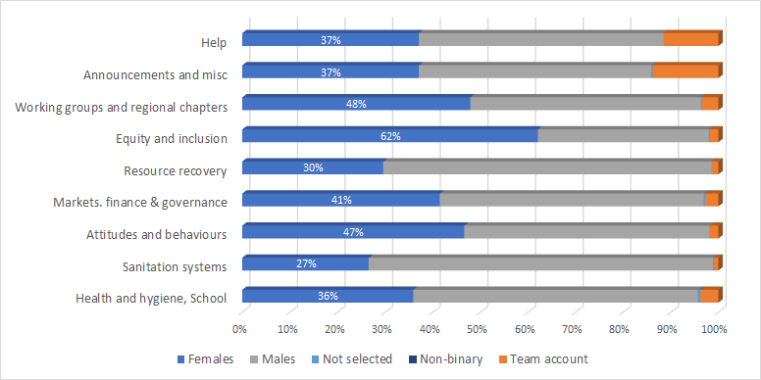
Gender of members who have posted, by category
In some categories, females make up half the posts - even though they only about one third of member
Females post particularly in „equity and inclusion“ category
Females don‘t post as much in „sanitation systems“ category
Team accounts post the most in announcements

Slide 60
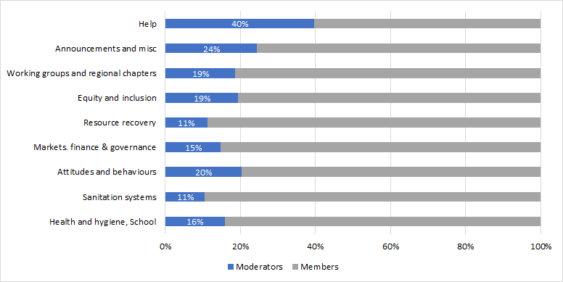
Moderators or members posts, by category
The percentage of moderator posts is higher in „Help“ and „Announcements“ which is to be expected

Slide 61
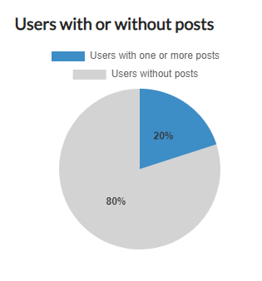
Forum posts per member (1)
20% of SuSanA members have made one forum post or more.
The vast majority of SuSanA members (80%) has never posted.
Note that people may become SuSanA members without the intention to utilise the Discussion Forum (the two database systems are coupled)
These statistics are live updated and are available here: https://forum.susana.org/forum/statistics?statsview=13

Slide 62
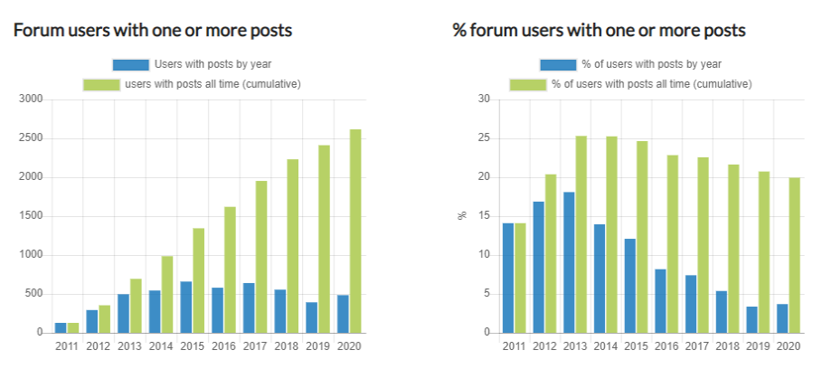
Forum posts per member (2)
About 2600 SuSanA members have made at least one post since the start of the Forum in 2011.

Slide 63
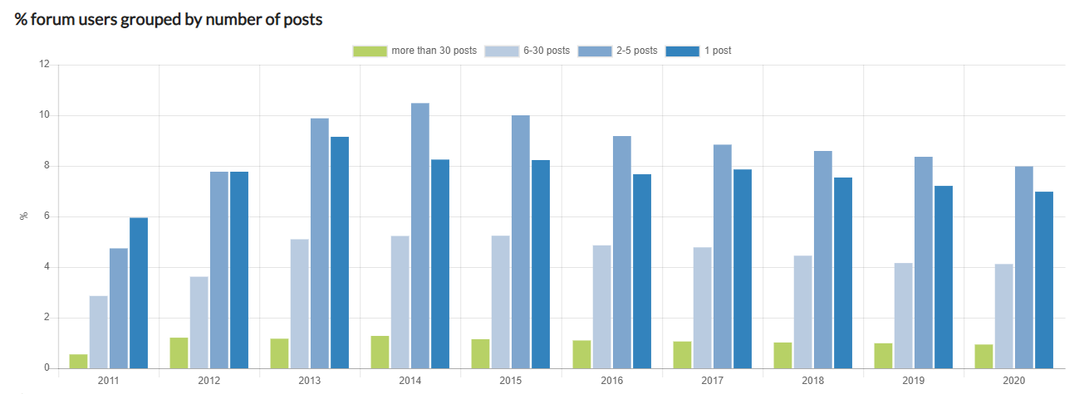
Forum posts per member (3)
1% of members have made a lot of posts (30 or more)
This is typical for the 1-9-90 rule of internet culture *
> 50 posts 6-30 2-5 1 post (cumulative posts, not per year)
8%
7%
4%
1%
* In a collaborative website such as a wiki, 90% of the participants of a community only consume content, 9% of the participants change or update content, and 1% of the participants add content. (https://en.wikipedia.org/wiki/1%25_rule_(Internet_culture)

Slide 64
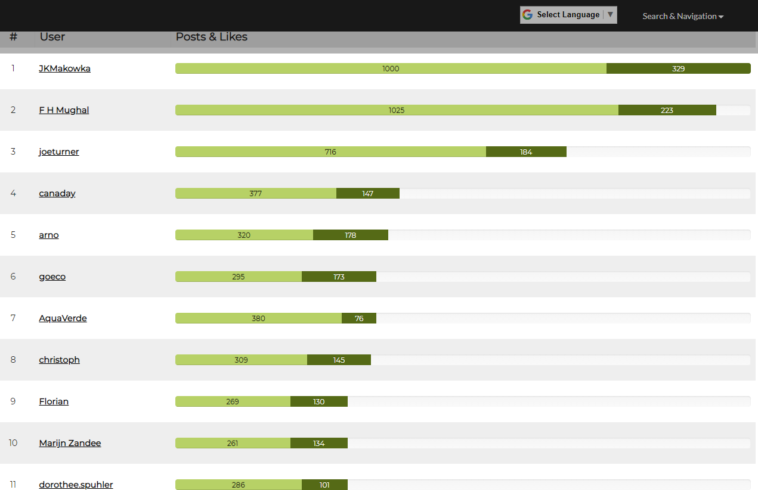
Most active users (top 50) ranked by posts and likes received
All “top 10” most active users (all time, since 2011) are male users.
Five of them have stopped since about 2018 or slowed down significantly (Mughal, Joe, AquaVerde, Christoph, Florian).
Source: https://forum.susana.org/forum/statistics?statsview=3
Elisabeth’s posts not shown here (they are 3142) because she has been main moderator from 2011 until now

Slide 65
back
5. Plans and conversations about the future
of the SuSanA Forum
See full discussion here: https://forum.susana.org/10-announcements-regarding-susana/24266-the-discussion-forum-survey-results-latest-developments-and-discussions-about-the-future

Slide 66
Our reactions to the results of the survey and member analysis (1):
Set ourselves membership targets for the future (how to achieve this?):
increase %-age of female SuSanA members from currently 36% to 50%.
increase %-age of members from Global South from currently 67% to 80%.
Set ourselves targets with regards to who posts (how to achieve this?):
increase %-age of posts by females from currently 41% to around 50%.
increase %-age of posts by members from Global South from currently 33% to around 80%.
Reduce the %-age of posts by moderators from currently 28% to 20% (or allow higher values if moderators are from Global South?).
Conceptualise which new categories or sub-categories should be created and how they would be supported and moderated. Investigate any overlapping topics with RWSN such as water supply, hygiene, handwashing and “leaving no one behind”.

Slide 67
Our reactions to the results of the survey and member analysis (2):
Investigate how to recommend SuSanA and the Discussion Forum as a knowledge management tool into institutions in Southern Africa. We will plan some pilot activities with institutions in Zambia.
Investigate social media marketing opportunities, e.g.
emerging tools that are being used widely by practitioners in developing countries, for example Whatsapp groups, LinkedIn.
a Whatsapp group, Telegram group or Slack channel to deepen the engagement of SuSanA members with the discussion forum. They might build a community feeling and be more inviting to those users who do a lot of their work from mobile phones.
Analyse implications, pros and cons of a password-less social media login (e.g. logging in with one’s gmail address). Such a system would likely mean decoupling SuSanA membership from discussion forum membership and would therefore require in-depth discussions before it is adopted.

Slide 68
Q19: What do you like the most about the SuSanA discussion forum?
Strengths
Description | Tally
The forum is informative and interesting with respect to: relevant information shared from field experience and research results, offers opportunities for learning and provides information on new developments in the sector as well as new experiences in different countries | 33
It is a reliable knowledge sharing platform | 26
It provides regular updates on WASH | 19
The forum has a strong focus on and good coverage of sanitation topics | 11
The forum offers diversity | 10
Is a reliable Networking platform | 7
The forum is well moderated | 6
The forum is Interactive | 6
The forum provides opportunities to gain new knowledge (including providing study opportunities) | 4
Interaction with different experts | 4

Slide 69
Q20: In your opinion, how could the forum or its moderation be improved? (1)
Weaknesses
Description | Tally
Lack of discussion or interlinkages with social media platforms | 8
Low member participation | 5
Fewer discussions on hygiene, water topics | 5
English is the only language used: other languages should be used | 4
Low responsiveness | 3
Moderators do not adequately represent all different regions | 2
Lack of occasional personal contacting | 1

Slide 70
Q20: In your opinion, how could the forum or its moderation be improved? (2)
Suggestions
Description | Tally
The forum needs to be improved by creating an easier to use web interface, adding new features to the platform to make posting and browsing through posts a lot easier than it is currently. | 13
It is time that the form extends its reach to other media platforms such as WhatsApp, Linkedin and Twitter. That way users can access forum discussions and contribute to discussions through other media available to them. | 8
Broaden focus to include more on other topics such as water and hygiene | 5
Discussions in other languages like Spanish and French required | 4
More expert engagement in discussions | 4
Improve moderation i.e The forum is over moderated and this hinders open discussions in some cases. Moderation can be improved to assist those that feel too intimidated to post. Younger users or novice practitioners may need some hand holding in the beginning by forum moderators | 3

Slide 71
Other discussion points about the future
Moderation & topics | IT aspects | Funding
Broaden scope to water supply topics (but would overlap with RWSN) and perhaps other topics? | Make it easier to post from mobile version somehow (voice to text maybe?) | Forum funding not clear beyond 2020
Consider how best to deal with „competition“ from social media platforms for discussion, in particular Facebook and Dgroups. Try to interlink better with social media? | Develop an App to make it easier to use forum from mobile phone (too expensive?) | Discussions with SHF (formerly WSSCC) ongoing
Are more forum posts automatically desirable? (questions around quality and diversity; how to measure quality of posts) | Create clearer statistical tools to analyse user behaviour; spend more time on interpreting data
How to encourage more people from Global South to post on the forum? E.g. More advertising at face-to-face events? Do people from Global South face other barriers to writing posts than people from Global North? | Keep thinking of ways to make forum „more modern“? | Keep in mind “organisational development” for SuSanA as a whole
Investigate if high %-age of moderator posts is indeed a problem (set a target of <20%?) | Create a language sensitive forum e-mail digest?
How to encourage more females to join SuSanA and to post

Slide 72
back
6. Appendix

Slide 73
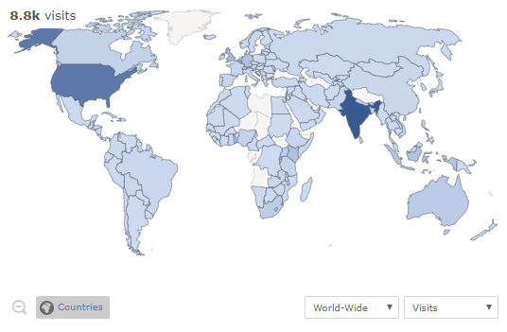
Visitor map for one month in 2019
India and the United States are the two countries where most visitors access the Forum from.
Legend:
Lightest colour is 1, darkest colour is 2.1 K
Time period: One month period ending 9 May 2019
Source: Piwik for SuSanA Forum

Slide 74
History of forum moderation and funding
January 2007: SuSanA started
July 2011: The Discussion Forum was launched and Elisabeth von Muench was Forum moderator until end of 2012, funded by GIZ
Nov 2012 to March 2019: The Forum moderation was mainly carried out by Elisabeth (funded by BMGF grant to SEI)
Years 2013-2014: Increased number of Forum posts as BMGF grantees were actively encouraged by Elisabeth to post about their research on the Forum
Nov. 2018: SuSanA members were informed about uncertainty of future funding for moderation, and asked for suggestions (here)
April to Oct. 2019: GIZ funded Elisabeth for “basic moderation” only
Nov. 2019: WSSCC stepped forward and agreed to fund forum moderation and more for 13 months, until December 2020
January 2021 onwards: maybe continued funding by WSSCC

Slide 75
Overview of activities of the Forum moderators (1 of 2)
The moderators may carry out the following admin type actions on a daily basis:
Move posts to other categories or threads where they fit better (and moving posts that have been sent by e-mail)
Break long threads into two, rename thread titles
Delete posts (such as spam) and ban abusive users.
Add a moderator’s comment at the end of somebody’s post, marked in blue colour (e.g. adding the English translation if the post was not in English, using either Deepl or Google Translate)
Look out for any activities that break the Forum rules, including any subtle comments that might cause offense through innuendo, hidden implication or sarcasm, and then deal with those
Contact members about their posts or help them with any technical issues

Slide 76
Overview of activities of the Forum moderators (2 of 2)
The moderators may also get involved in content creation by:
making meaningful contributions
writing the first reply to unanswered posts to raise attention for them
providing links to related previous discussion threads
e-mailing others to encourage new contributions

Slide 77
As of Year 2020: A new model of one head moderator and several co-moderators
The “head moderator” is a paid part-time position which has overall responsibility (Elisabeth von Muench)
Under the guidance of the head forum moderator there are two paid part-time co-moderators from the Global South
The co-moderators:
Are responsible for certain categories of the forum and for certain regions (e.g. currently it is Paresh for Asia and Chaiwe for Africa)
Work 1-2 days per week
Co-moderators to work quite independently, take initiative and activate other members in their regions or professional networks to participate in the forum.

Slide 78
Overview of moderator tasks that are done frequently
Task
Read and check each and every post (and link!) as soon as possible
Gently edit posts for typos and formatting
Check all links given in a post
Delete a post and contact user to initiate a conversation
Add comments to people’s posts
Write a forum post
Task
Improve thread titles
Move posts that were sent in via e-mail
Move a post to an existing thread
Move a thread into another sub-category
Add translation to a forum post

Slide 79
Overview of infrequent moderator activities
Task
Highlighting conference presentations
Help users who did not get a reply yet
Check internal contact usage
Check for trends on the statistics pages
Task
Review if threads are in the wrong categories
Make a thread into a super sticky (or featured) thread
Creating new sub-categories or sub-sub-categories
Update special forum pages

Slide 80
Overview of optional extensions
Optional extension
Updating Wikipedia articles with information gleaned from forum posts and vice versa
Improving and updating the key readings for Forum sub-categories
Getting involved in the thematic discussion series (TDS)
Promotion of specific discussions or the Discussion Forum in general

Slide 81
Which parts of the Forum cost money?
Time of one or several moderators; this is variable, depending on level of ambition
Server (the same server hosts the SuSanA website and Forum; the company is called Strato and is in Germany); this is only a minor cost
Time for ongoing IT support to fix bugs, improve user experience, upgrades to latest version when required
The Forum is based on Kunena software* which is a free but we have paid IT developers Dotwerkstatt in Berlin to program several additional features (funded by GIZ and BMGF grant) – see later in this presentation for details
The time requires is variable, depending on level of ambition
Optional: regular user surveys or user experience observations
* Kunena open source communication platform extension for Joomla (Joomla is a free and open-source content management system (CMS) for publishing web content – it is used for the SuSanA website)

Slide 82
Who are current and previous funders of the Forum?
The Forum and SuSanA website are administered by the SuSanA secretariat at the GIZ, Germany who receive funds by the German Federal Ministry for Economic Cooperation and Development (BMZ) to operate the SuSanA secretariat since early 2007.
From Nov. 2012 until Oct. 2018, co-funding for some aspects of SuSanA’s work, including the Forum, was provided by the Bill and Melinda Gates Foundation.
From November 2019 until December 2020 funding of the forum moderation was provided by WSSCC via a grant to Skat Foundation

Slide 83
Updating Wikipedia articles with information gleaned from forum posts and vice versa
Forum discussions that led to improved Wikipedia articles:
Example 1: CBS, see here (a post on Discussion Forum in June 2019 about a publication by Worldbank about CBS)
Example 2: A user made a post about a newspaper article on menstrual cups in Kerala here. The moderator subsequently added this information to the Wikipedia article on menstrual cups here.
Wikipedia discussions that led to posts on the Forum:
Example 3: There was a discussion on the talk page of the Wikipedia article about squat toilets here. The moderator then made a forum post about it here to gather more information on squat toilets.

Slide 84
Figures which could be interesting to look into in future analyses
How much the Forum gets used in comparison to the main website (views, actions, duration)
What refers traffic to the Forum, compared to traffic to the main website
Where do the outlinks go to (i.e. from Forum to somewhere else)
Comparing different time periods, observing trends within the year or by comparing current year to last year
(This kind of work is time consuming though and requires some experience with website analytics)

Slide 85
Possible reasons for periods with lower number of forum posts, page actions or visits
For 2019: Lower activity levels of the moderator due to reduced funding
Years 2013-2015 were particularly high because BMGF grantees had incentive or mandate to post about their projects
Some “hyper-active users” took part in that period but have now moved on. (see also slide in Appendix)
A lot of content can already be found simply by reading the Forum without a need to actually make a post and asking questions.
More competition from other platforms, such as social media, Dgroups
🡪 See also the survey results for “barriers to posting” (in Part 3)
→ Quantity of forum posts does not equal to quality or diversity

Slide 86
Quiz questions
How many SuSanA members are there?
Which is the country with the most SuSanA members?
What percentage of our members are female?
What percentage of our members is from the Global South?
How many forum posts were made in the year 2019?
Which forum category has the most posts?
What the total number of forum posts (all time)?

Slide 87
Answers
How many SuSanA members are there? 13,100
Which is the country with the most SuSanA members? India, 2020
What percentage of our members are female? 36%
What percentage of our members is from the Global South? 67%
How many forum posts were made in the year 2019? 1816
Which forum category has the most posts? Sanitation systems
What the total number of forum posts (all time)? About 26,000
(Values current to 10 December 2020)

Slide 88
Useful links about the forum
Most important:
Watch a video about the forum here (direct Youtube link here)
Read the presentation about SuSanA Discussion Forum and the Moderator Guide from 2019: https://www.susana.org/en/knowledge-hub/resources-and-publications/library/details/3630
Other information to read:
About the Forum: https://forum.susana.org/about
Rules of the Forum: https://forum.susana.org/forum/rules
Forum help section, in particular the section about the basics: https://forum.susana.org/forum/categories/133-registration-login-and-first-steps
Overview all Forum categories: https://forum.susana.org/forum/categories

Slide 89
Main author: Elisabeth von Muench, member of Forum Practice Group, funded by WSSCC
Reviewers: members of the Forum Practice Group
Last updated: 15 December 2020

