Slide 1
7. SuSanA Library

Slide 2
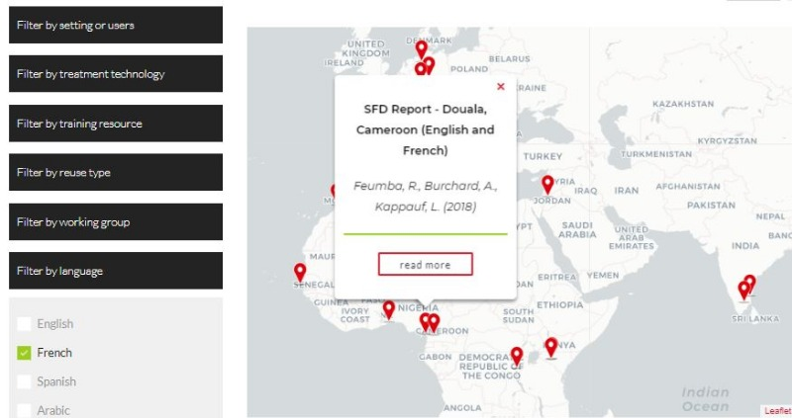
Library:
Over 3,000 documents, case studies, presentations etc. related to sustainable sanitation. Can be sorted by:
Type of resource
Setting or users
Treatment technology
Training resource
Reuse type
Working group
Language
SuSanA publications and recommendations
Region or Country
Partners can have their publications uploaded in the SuSanA library
Open source concept applies to all content in the library
Publication that have been uploaded in the library can also be discussed in the SuSanA forum
Each reference has also a useful description
Search and advanced search functions, location pins for entries
Notes:
2

Slide 3
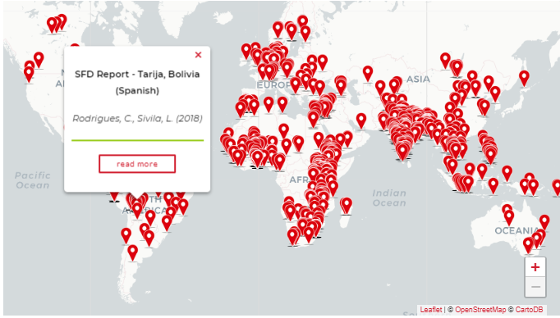
1367 library entries have a location pin as of September 2019
See here: https://www.susana.org/en/knowledge-hub/resources-and-publications/library#map Each pin stands for a library document that is specific to a location. You can zoom in and out of the map. The pins are interactive: by hovering over the pins you can get a quick overview of which publications are specifically about your region of interest.

