Slide 1
4. What is SuSanA?
SuSanA’s Mission, SuSanA’s beginnings, evolution, outcomes and impacts

Slide 2
What is SuSanA?
SuSanA is a loose, dynamic and global network of individual members and partner organisations working along the same lines
→ further organisations are welcome to join
Goal: to contribute to the achievement of the SDGs by promoting sanitation systems which take into consideration all aspects of sustainability, i.e. health and hygiene, environmental and natural resources, technology and operation, finance and economics, socio-cultural and institutional (SuSanA vision document)
SuSanA members and partners have agreed on a vision document
All partnering organisations contribute their work and resources on their own expense
SuSanA currently has 13 thematic working groups and 3 regional chapters
Notes:
2

Slide 3
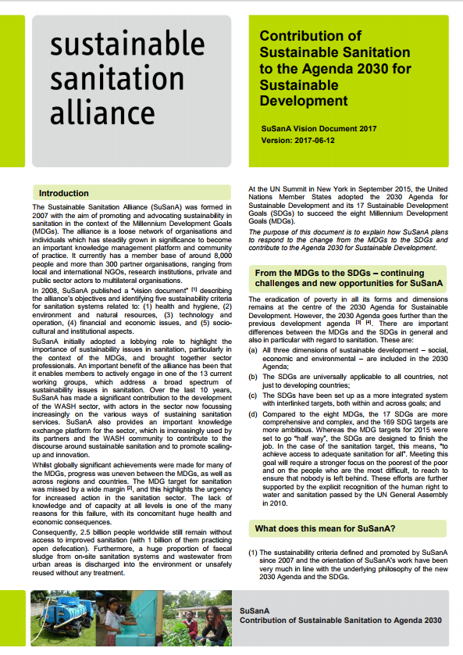
SuSanA‘s vision document
Following the 2030 Agenda and its 17 SDGs with a focus on “Clean water and Sanitation”, SuSanA was motivated to create a new vision document as a response to the new Development Goals.
The new vision document explains how SuSanA plans to respond to the change from the MDGs to the SDGs and contribute to the Agenda 2030 for Sustainable Development.
The additional interlinkages document “Sustainable Sanitation and the SDGs: interlinkages and opportunities” describes how sustainable sanitation links to all SDGs and outlines challenges and opportunities this represents.

Slide 4
SuSanA‘s Mission
“SuSanA is an open international alliance with members who are dedicated to understanding viable and sustainable sanitation solutions. It links on the ground experiences with an engaged community made up of practitioners, policy makers, researchers, and academics from different levels with the aim of promoting innovation and best practices in policy, programming and implementation.”
Source: https://www.susana.org/_resources/documents/default/3-2867-7-1506594634.pdf (SuSanA Joint Roadmap 2015 to 2018 – Towards More Sustainable Sanitation Systems)

Slide 5
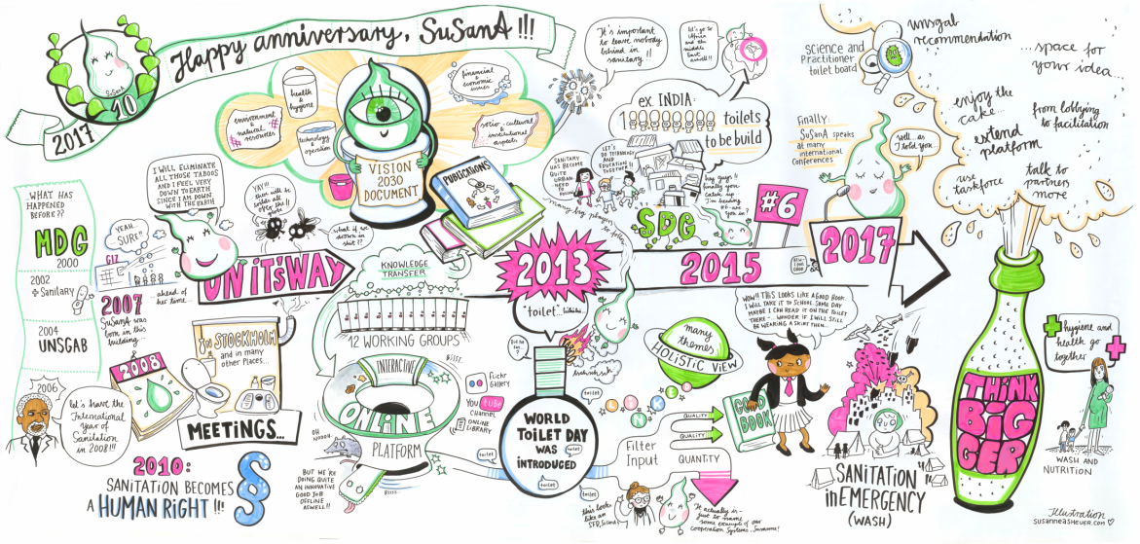
SuSanA's 10th Anniversary Celebration
January 2017: Celebration of the Sustainable Sanitation Alliance’s (SuSanA) 10th anniversary in Eschborn, Germany where SuSanA was founded in 2007
Theme: "10 years SuSanA: How the changed sanitation paradigm contributes to the Sustainable Development Goals“
SuSanA’s achievements, milestones and impact in the sanitation sector were reflected upon. The way forward was paved and the alliance’s contribution to the 2030 Agenda for sustainable development was discussed.

Slide 6
How did it start? Ten years ago…
The International Year of Sanitation (IYS) in 2008 triggered SuSanA
January 2007: Kick-off meeting in Eschborn, Germany – initially the aim was to prepare & align for the International Year of Sanitation in 2008

Slide 7
The International Year of Sanitation (IYS) in 2008 triggered SuSanA
UNSGAB suggested IYS (in Feb. 2006 within Hashimoto Action Plan)
Decision of the UN for the IYS 2008 (in December 2006)
Objectives of the IYS (formulated by UNSGAB in May 2007):
increase of awareness & commitment from actors at all levels
mobilisation of governments, financial institutions & sanitation providers
secure real commitments to develop & implement effective action to scale up sanitation programmes
encourage demand driven sustainable solutions & informed choices
secure increased financing to jump start & sustain progress
develop & strengthen institutional & human capacity
enhance sustainability & effectiveness of sanitation solutions
promote & capture learning to enhance evidence base & knowledge on sanitation

Slide 8
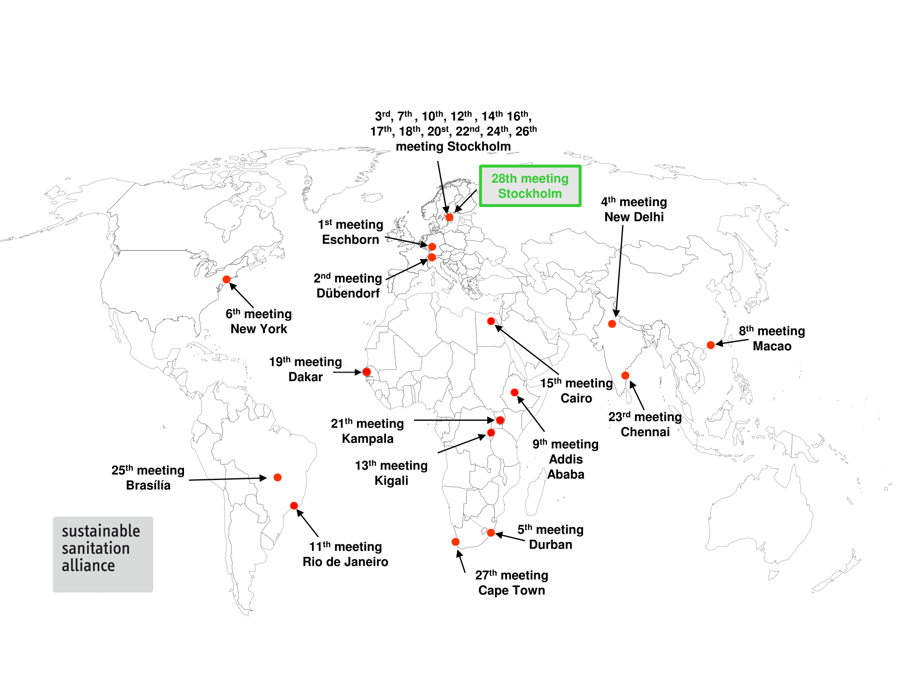
28 SuSanA meetings so far around the globe
Notes:
Updated 23 Aug. 2012

Slide 9
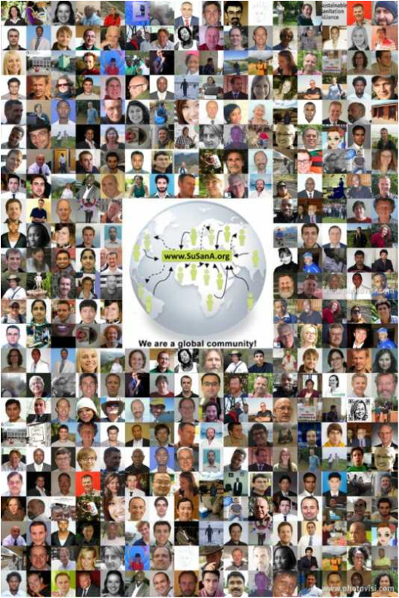
We are a global community

Slide 10
How big is SuSanA? (Status: October 2019)
353 partner organisations
11,200 individual members (= people registered for the discussion forum)
SuSanA reach:
12,200 Newsmail subscribers
9,400 Facebook followers
4,500 Twitter followers

Slide 11
Member increase over time since start of website on 26 June 2008
When people register to use the forum they automatically become SuSanA members, and vice versa.
The number of SuSanA members equals the number of forum users.

Slide 12
Location of SuSanA members in 2019
549 (UK)
564 (Germany)
932 (USA)
1647 (India)
Countries with most members:
India
USA
Kenya
Germany
United Kingdom
576 (Kenya)
Date: 9 May 2019
Source: Forum Statistics Page, based on self-identification of members during registration process

Slide 13
How is SuSanA funded?
SuSanA is based on voluntary contributions and has no legal structure, nor budget or income.
Partners contribute time/resources from their own budgets as it creates synergies with their normal work
SuSanA secretariat (approx. 2 full time person equivalents) is funded by BMZ (German Ministry for Economic Cooperation and Development) who has commissioned GIZ
From 2012 to 2018, co-funding for the discussion forum was provided by the Bill and Melinda Gates Foundation through Stockholm Environment Institute (SEI)
Regional chapters are funded by SuSanA partner organizations
For the year 2020, co-funding for the discussion forum is provided by the Water Supply and Sanitation Collaborative Council (WSSCC) through the Skat Foundation

Slide 14
SuSanA‘s Project Database

Slide 15
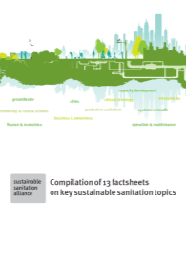
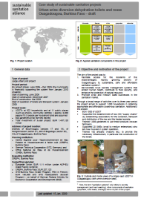
What did we achieve?
Selected outputs:
Compilation of 13 factsheets on key sustainable sanitation topics
Output of the 13 working groups (multi-authored, represents consensus)
82 case studies on sustainable sanitation projects (impartial, objective, QA-checked):
Costs and economics, O&M, practical experience and lessons learnt and sustainability assessment and long-term impacts
www.susana.org/case-studies

Slide 16
Further output examples
Extensive online library for sustainable sanitation publications (3100 documents in December 2019)
Online discussion forum on sustainable sanitation issues, making discussions publicly available for the first time (https://forum.susana.org/)
Presentation ‘Everything there is to know about the Forum’: https://www.susana.org/en/knowledge-hub/resources-and-publications/library/details/3630
Largest photo database on the topic of sustainable sanitation (currently over 11,900 photos on Flickr)
28 meetings globally (14 of these outside of Europe)
A vibrant and supportive community

Slide 17
What are the impacts of SuSanA’s work? (slide 1 of 2)
Sustainability firmly on the map now in the sanitation sector
Post-2015 draft goal: Universal use of sustainable sanitation services that protect public health and dignity (SuSanA representation on sanitation working group)
Other players have picked up on the theme of innovative sanitation (with resource orientation), most notably Bill and Melinda Gates Foundation
SuSanA meetings have moved from being a marginal group to mainstream, e.g. inclusion in World Water Forum in Brasilia 2018, AfricaSan5/FSM5 in Cape Town 2019
Sustainable sanitation in nexus dialogue, food security theme at WWW in 2012

Slide 18
Impacts continued (slide 2 of 2)
Better cooperation and knowledge exchange between 353 partner organisations
The voice of 353 partners together is stronger than the voices of 353 separate organisations…
More widespread use of a range of approaches, for example CLTS, productive sanitation, sanitation as a business, fecal sludge management (FSM)
Connections to the humanitarian sector (emergency sanitation), (menstrual) health sector and education sector (WASH in schools)
Systems approach to sanitation is firmly on the agenda

Slide 19
Excerpts from the SuSanA Vision:
The General objectives of SuSanA:
to highlight the importance of sustainable sanitation systems and services for achieving many of the targets across the SDGs;
to actively reach out to other sectors, enable both intra- and cross-sectoral dialogue/collaboration and encourage multi-sector approaches; and
How to achieve the objectives?
The organisational structure, the thematic orientation of the working groups, and the existing fact sheets which were developed by the thematic working groups during the MDG period will be reviewed and adapted, particularly with regard to meeting the challenge of “leaving no one behind” and grasping the new opportunities to reach out to, influence and cooperate with other sectors.

Slide 20
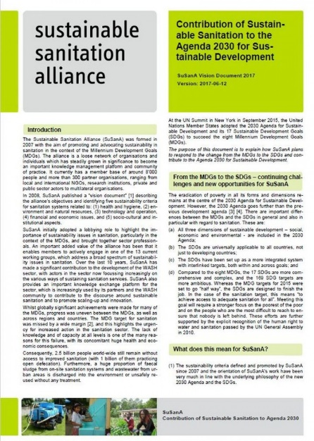
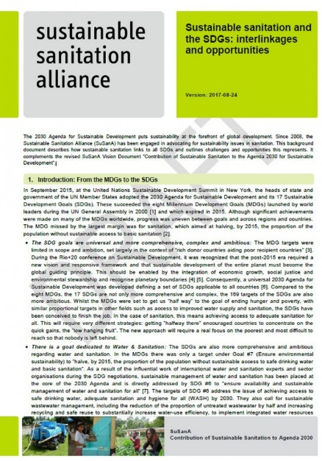
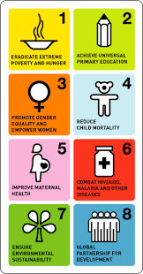
Background
SuSanA Vision update in relation to the SDGs;
Interlinkages document to support new vision document;
Consultative process within the network;
Global launch at the 24th SuSanA Meeting in Stockholm, 2017

Slide 21
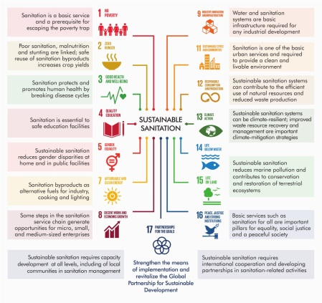
Re-cap of the Interlinkages document

Slide 22
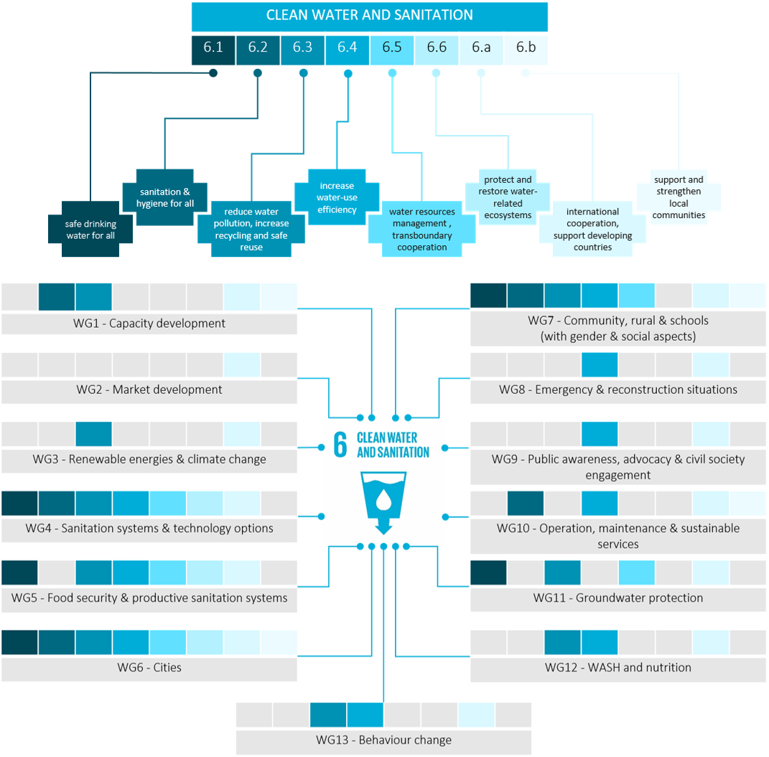
Infographics – SDG 6 and the WGs

